Slide 1

ASTRO CATS
Preliminary Design Review Presentation
Notes:
Aaron

Slide 2
Team
Nicholas Fagan – Team Lead
Brandon Horne – Payload Lead
Kevin Eliason – Rocket Lead
Aaron Deutsch – Safety Lead
Andrew Auffenberg
Caleb Wasmund
Justin Malloney
Cameron Crippa
Gabriel Punte-Lay
Jake Chesley
Notes:
Aaron

Slide 3
Presentation Outline
Project Statement
Project Budget, Schedule and Objectives.
Vehicle dimensions, materials, and justifications
Static Stability Margin
Plan for vehicle safety verification and testing
Baseline motor selection and justification
Thrust-to-weight ratio and exit rail velocity
Launch vehicle verification and test plan overview
Drawing/Discussion of each component and subsystem
Baseline Payload Design
Payload verification and test plan overview
Upcoming Team Events
Notes:
Aaron

Slide 4
Project Statement
The Astro Cats will win the NASA University Student Launch by developing a vehicle capable of deploying a planetary probe to approximately 1 mile above ground level. The probe will be deployed via a custom fairing system and will capture atmospheric data. The data will then be transmitted via radio to a ground station. This system will be developed for under $7,500.
Notes:
Aaron

Slide 5
Level 1 Safety Analysis
Please be aware of any hazards that exist in the room
Tripping hazards – cords, chair legs, and backpacks
Pinch points – hands with doors and hands in between chairs and desks
In the event that we need to evacuate please exit the building out the main entrance and meet in quad.
In the event that we need to shelter in place please make your way to the 400 level of Baldwin and shelter in the hallway.
Notes:
Aaron

Slide 6
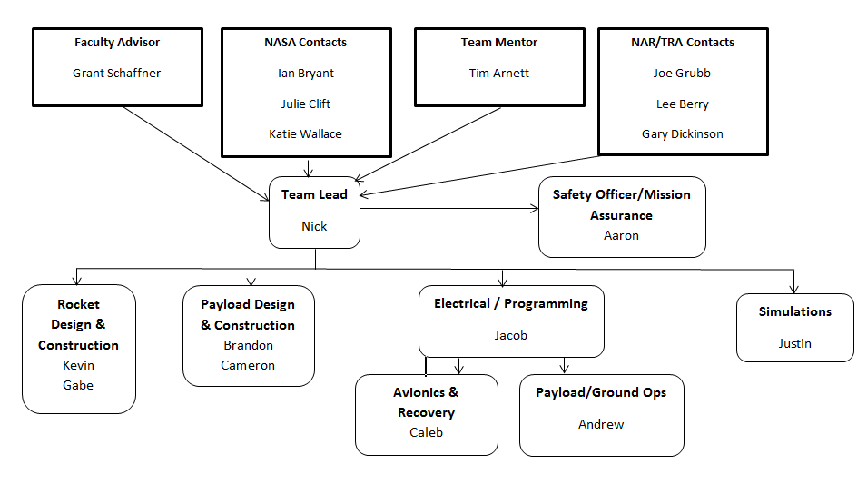
Work Breakdown Structure
Notes:
Aaron

Slide 7
Project Budget
Started purchasing components Oct 14th
Currently under initial proposed budget by $991
Notes:
Nick

Slide 8
Project Funding
Already secured funds from UC SEDS & Aero department
Plan to present project presentation to companies requesting funds in December
In the process of completing OSGC Grant
Notes:
Nick

Slide 9
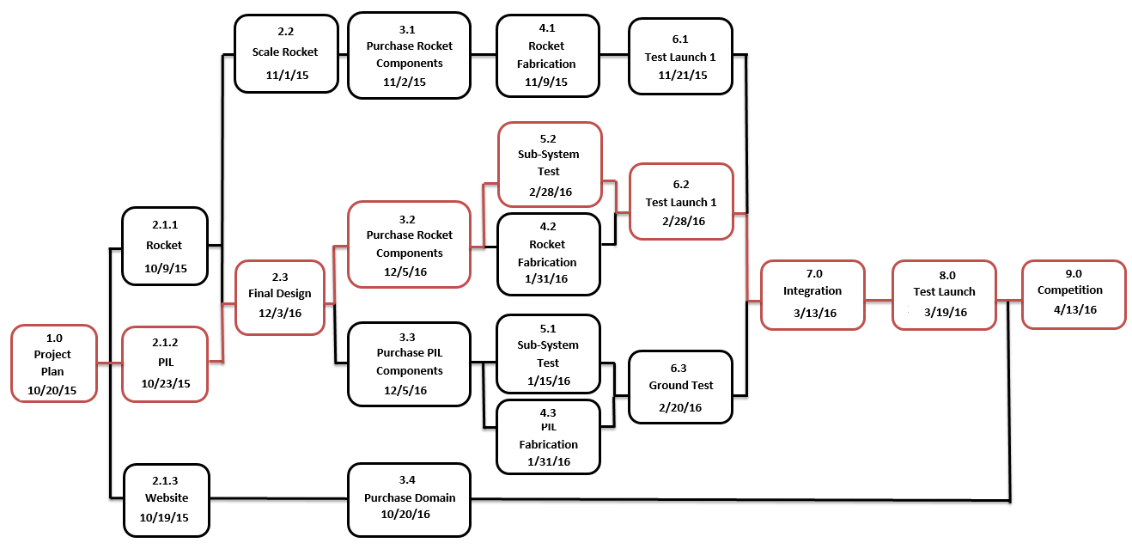
Notes:
Nick

Slide 10
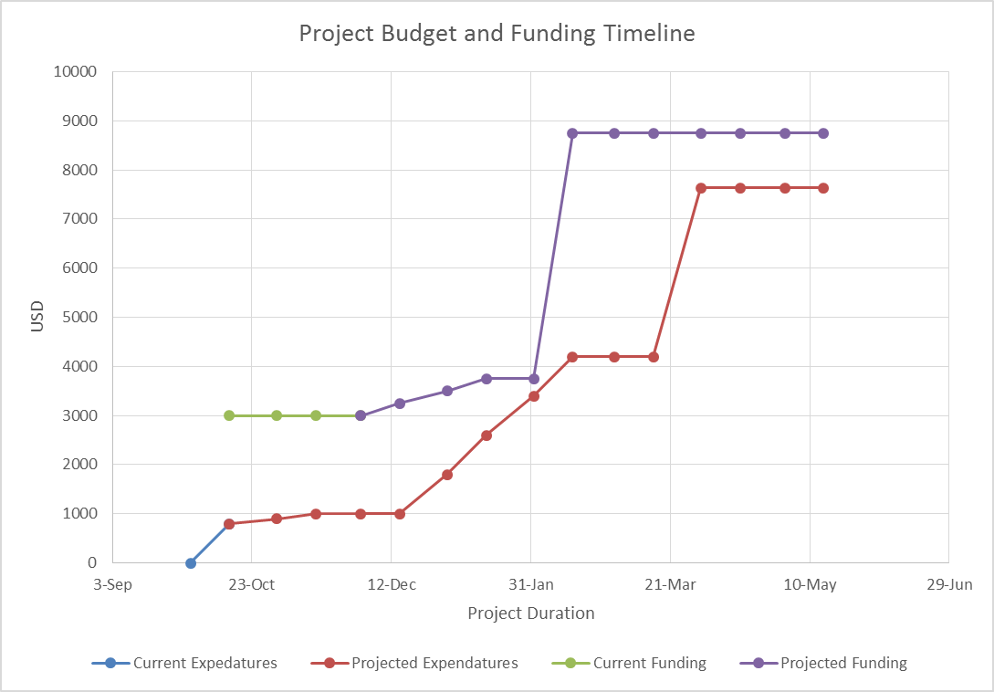
Notes:
Nick

Slide 11
Launch Vehicle Objectives
Vehicle shall deliver the payload to as close to 5,280 ft (AGL) as possible.
Vehicle shall be reusable after recovery.
Tracking bay shall transmit position data back to ground station.
At landing, each independent section of the launch vehicle shall have a maximum kinetic energy of 75 ft-lbf.
Vehicle will deploy parachutes via stratologger altimeters
Notes:
Nick

Slide 12
Payload Objectives
The payload shall deploy at apogee
The payload shall collect atmospheric measurements
The payload shall take pictures
The payload shall remain in orientation during descent and after landing
The data from the payload shall be stored onboard and transmitted wirelessly to the ground station
The payload will be reusable after the mission
Notes:
Nick

Slide 13
Launch Vehicle Overview
Design Overview
Fairing Design
Fin Design
Motor Selection
Tracking Bay Design
Integration
Mass Breakdown
Notes:
Nick

Slide 14
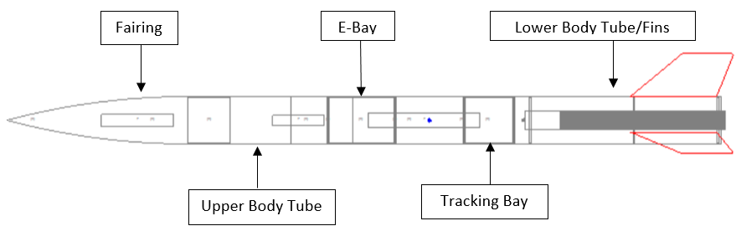
Launch Vehicle Design
Total length: 84.4 inches
Airframe Diameter: 5.54”
Fin count: 3
Empty weight: ~12 lbs
Loaded weight: ~19 lbs
Center of Gravity: 46.79”
Center of Pressure: 57.99”
Stability Margin: 2.04
Number of Subsections: 4
Notes:
Kevin

Slide 15
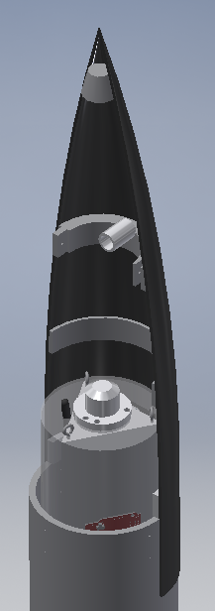
Fairing Design
Mold made from standard 5.54” plastic nosecone
Layers of 4 oz. and 6 oz. fiberglass and epoxy resin
Interlocking machined polymer rib structure
Overlapping tab to reduce airflow leakage
Nylon shear screws to join pieces
Tethered to P.I.L. parachute
Notes:
Kevin

Slide 16
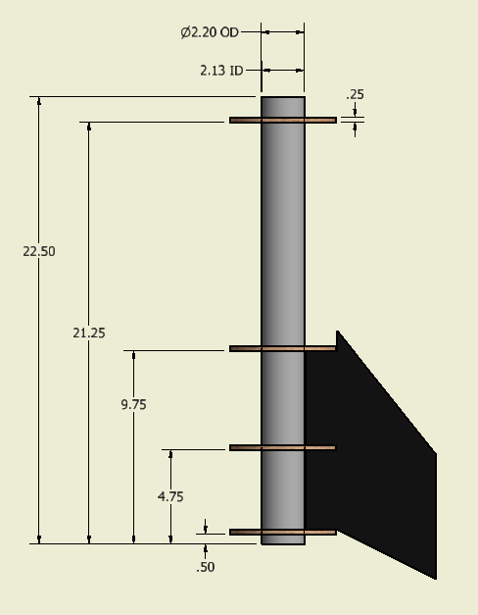
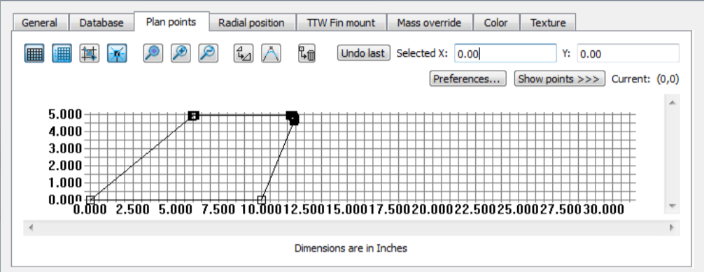
Fin Design
Fin Count: 3
1/16” G-10 Fiberglass plastic core
5lb. Divinycell foam shaped to airfoil
6oz. Fiberglass and epoxy shell
Permanently attached to lower body tube
Notes:
Kevin

Slide 17
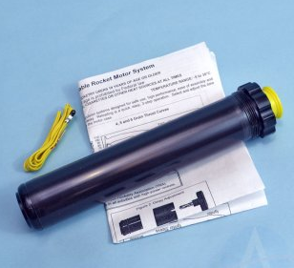
Motor Selection
Motor: Cesaroni – P54-5G Classic (K570)
Size: 54 mm
Burn time: 3.6 sec
Total Impulse: 2062.9 Newton-Seconds
Max Thrust: 892.7 Newtons
Mass: 1685.0 grams
Delay charge will be removed
Notes:
Kevin

Slide 18
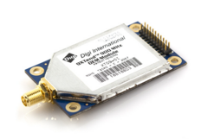
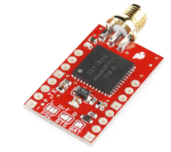
Tracking Bay
Components:
Arduino Mega
XTEND-900 radio transceiver
Venus GPS Module
Radio and GPS Antenna
Battery
Communicates vehicle position data back to ground station in real time.
Notes:
Jake

Slide 19
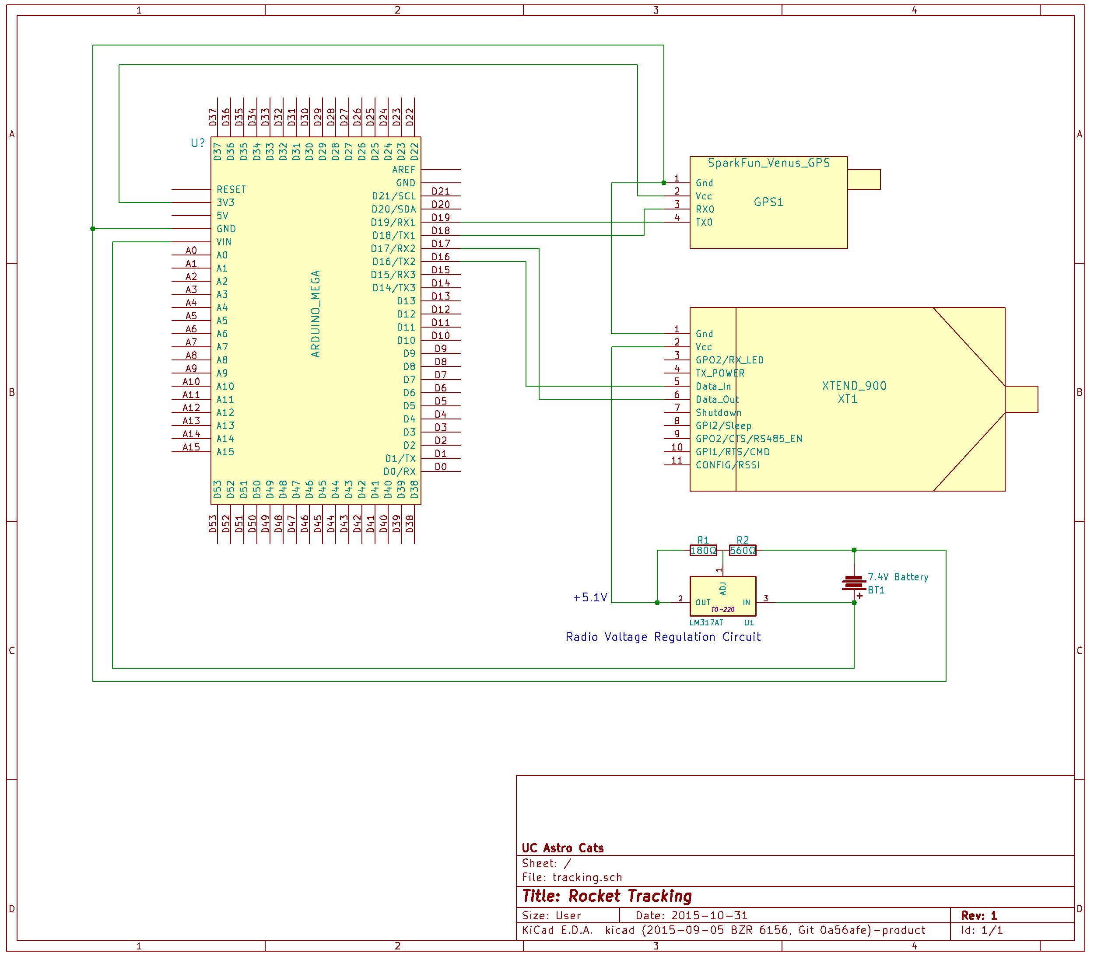
Tracking Bay Electronic Schematic
Notes:
Jake

Slide 20
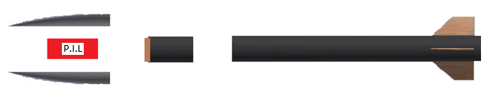
Integration
2 separation points – fairing and below recovery bay
P.I.L. housed in fairing
Drogue chute in upper section beneath the P.I.L.
Main chute in lower section between Recovery and tracking bays
Notes:
Gabe

Slide 21
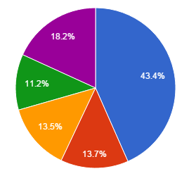
Mass Breakdown
P.I.L.
Subsection | kilograms | lbs
Total Lower Section Mass | 3.61 | 7.97
Total Upper Section Mass | 1.14 | 2.51
Total Recovery Bay Mass | 1.13 | 2.48
Total Tracking Bay Mass | 0.94 | 2.06
Total P.I.L. Mass | 1.52 | 3.34
Total Mass |  | 18.36
Lower Section
Tracking Bay
Recovery Bay
Upper Section
Notes:
Gabe

Slide 22
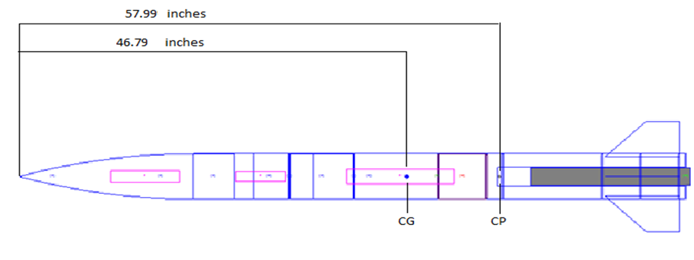
Static Stability Margin
 | On Launch Pad | After Burnout
CP (from tip) | 57.99 in. | ---
CG (from tip) | 46.79 in. | 43.15 in.
Static Margin | 2.04 | 2.70
Notes:
Gabe

Slide 23
Motor Selection, thrust-to-weight ratio, exit rail velocity
Currently we are using a Cesaroni K570 which has a total impulse of 2070.258 N-Sec and a 3.9 sec. burn time
Preliminary test show a total altitude of 5,740.30 feet.
Thrust-to-Weight Ratio: 6.77
Max velocity: 659.24 feet/second
Exit rail velocity: 64.22 feet/second
Also considering using a Cesaroni K750-RL which has a total impulse of 2361.966 N-Sec and a 3.14 sec. burn time
Preliminary test show a total altitude of 6,638.85 feet.
Thrust-to-Weight Ratio of 8.53
Max velocity of 765 feet/second
Exit rail velocity: 41.4223 feet/second
Notes:
Gabe

Slide 24
Launch Vehicle Testing Plan
Launch Vehicle
Subscale launch
Wind tunnel
Parachute drop tests
Full scale launch– simulated payload
Full scale launch – full integration
Fairing
Pop tests
Impact and vibration testing
Electronics
Radio communication tests
Altimeter vacuum test
Notes:
Gabe

Slide 25
Parachute Summary
Section | Surface Area (ft²) | Drag Coefficient | Descent Rate (ft/sec) | Kinetic Energy at impact (ft-lbf)
Main Parachute | 57 | 1.26 | 14.2 | 35.3
Drogue Parachute | 7.1 | 0.75 | 46 | -
PIL Parachute | 12.6 | 0.75 | 22.5 | 44.6
Notes:
Caleb

Slide 26
Recovery Systems
Parachute Summary
PIL Recovery System
Rocket Recovery System
Ejection Charges
Attachment Method & Durability
Notes:
Caleb

Slide 27
PIL Recovery System
The PIL recovery will be a single parachute.
The PIL will deploy its parachute at apogee.
PIL Parachute: Public Missiles PAR-60HD
Descent rate is approximately 22.5 (ft/sec)
Current mass calculation: 5.7 lbs.
Notes:
Caleb

Slide 28
Rocket Recovery System
The rocket will be a two stage deployment after releasing the PIL.
A drogue parachute will deploy five seconds after apogee.
Drogue Parachute: 36” LOC LHPC-36
Slows descent rate to approximately 46 (ft/sec)
Current mass calculations: 11.3 lbs.
A main parachute will deploy at 600 feet (AGL).
Main Parachute: SkyAngle CERT-3 Large
Slows the rocket to an approximate final descent rate of 14.2 (ft/s)
Current mass calculations: 13.4 lbs.
Notes:
Caleb

Slide 29
Ejection Charges
Two black powder charges will be used for both the drogue and main parachute.
Each parachute deployment will have a 1.5 gram main charge and a 2 gram redundant charge.
Pop-tests will refine these values.
The Recovery Bay Sled will have three StratoLogger altimeters.
Strat 1 – Deploys main charge for faring and main parachute
Strat 2 – Deploys main charge for the drogue and back-up for main parachute
Strat 3 – Deploys back-up drogue charge
Notes:
Caleb

Slide 30
Attachment Method & Durability
Attachment method for all parachutes will be the rip-stop nylon provided with each and additional nylon suspension supports.
Rip-stop cords will be attached via eyebolts imbedded into the bulkheads of the Recovery Bay.
The load capacity of each parachute is not exceeded per suppliers provided calculators.
Notes:
Caleb

Slide 31
Drift-Wind Speed
Assumptions
Sustained wind speeds change with a normal distribution
The standard deviation is 2 feet/sec
Next steps
Research and gather experimental data either supporting the current wind behavior, or find data to model a more accurate distribution
Graph to the right shows the wind speed distribution at a mean of 5 MPH (7.33 feet/sec). This was done for 0,5,10,15, and 20 MPH.
Notes:
Justin

Slide 32
Drift-Single Run
Assumptions
Apogee is always 5,280 feet
Wind speed probability is a normal distribution
On the right is a single drift estimate at 5 MPH
Payload descends at a constant rate.
The rockets main parachute is deployed at 600 feet
Notes:
Justin

Slide 33
Drift-Multiple Runs
Assumptions
1 Degree-of-Freedom system
All assumptions stated above apply.
The graph on the right shows a distribution of total drift at 5 MPH for the rocket.
This was done for both the rocket and the payload at 0, 5, 10, 15, 20 MPH
Can help us accurately predict landing zones
Notes:
Justin

Slide 34
Drift Range
Wind Speed MPH | Rocket Drift Feet | Payload Drift Feet
0 | 0 | 0
5 | 1,049-1,095 | 1,733-1,791
10 | 2,123-2,169 | 3,498-3,557
15 | 3,195-3,241 | 5,260-5,320
20 | 4,268-4,313 | 7,024-7,083
Notes:
Justin

Slide 35
Science Value
Data taken will reinforce the scientific knowledge base
Create plots of variables vs altitude
Use pressure sensor to find altitude
Will analyze plots using MATLAB and other software
Look for points of interest and abnormalities
Compare to known atmospheric models
Plot errors compared to our data
Camera data will be analyzed visually for points of interest
Notes:
Justin

Slide 36
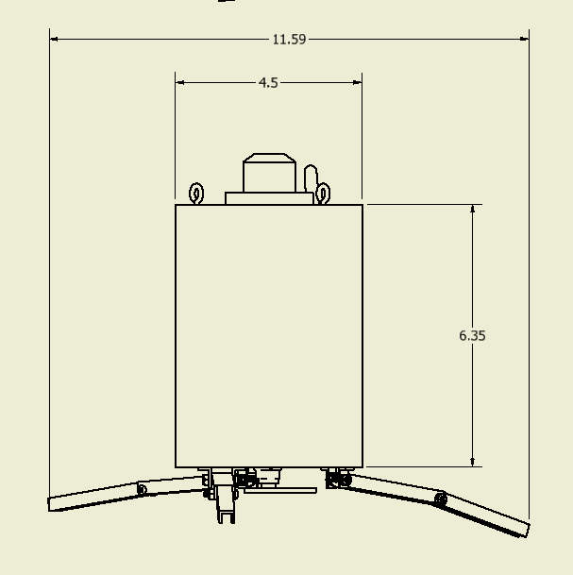
Payload Design Overview
Planetary Investigation Lander (PIL) Structure
Landing Module
PIL Hardware
Ground Control
Integration
Mass Breakdown
Notes:
Cameron

Slide 37
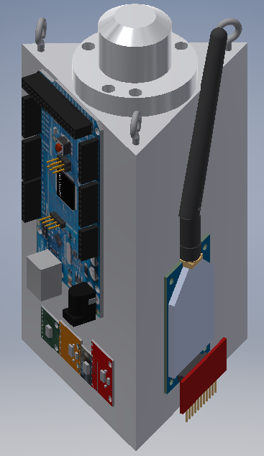
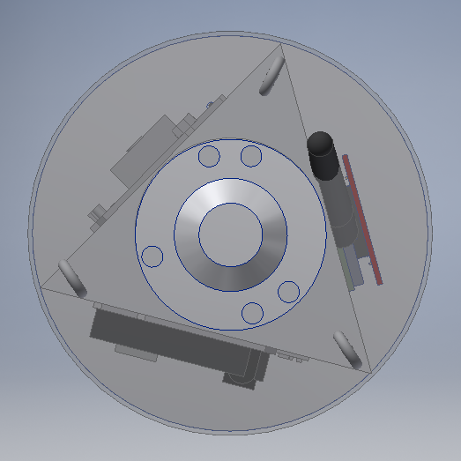
PIL Structure
Polymer Tri-structure for mounting
Clear acrylic PIL housing
Parachute connections mounted directly to main structure
Aluminum Landing base plate
Notes:
Cameron

Slide 38
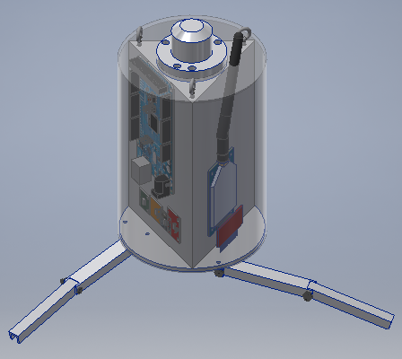
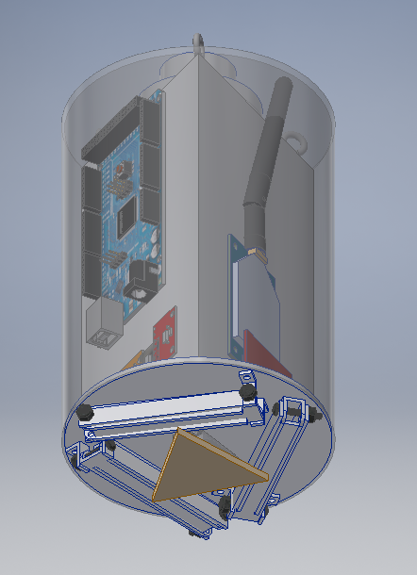
Landing Module
Torsion spring leg deployment
Servo-motor with triangle retaining plate
Notes:
Cameron

Slide 39
PIL Hardware
Arduino Mega 2650 – Microcontroller
XTEND 900 – 1 Watt 900 MHz radio
SparkFun Venus GPS – GPS Module
RHT03 – Temperature and Humidity sensor
Two used with alternating polling.
BMP180 – Barometric sensor
ML8511 – UV Sensor
Notes:
Jake

Slide 40
PIL Hardware Continued
Apogee Instruments SP-215 – Pyranometer
continuously outputting voltage relating to solar irradiance (W/m²).
ADXL345 – Accelerometer
LS-Y201-2MP - JPEG Color camera
SparkFun microSD Transflash
microSD Breakout board to write data to microSD
Backup data storage in case of radio failure
Notes:
Jake

Slide 41
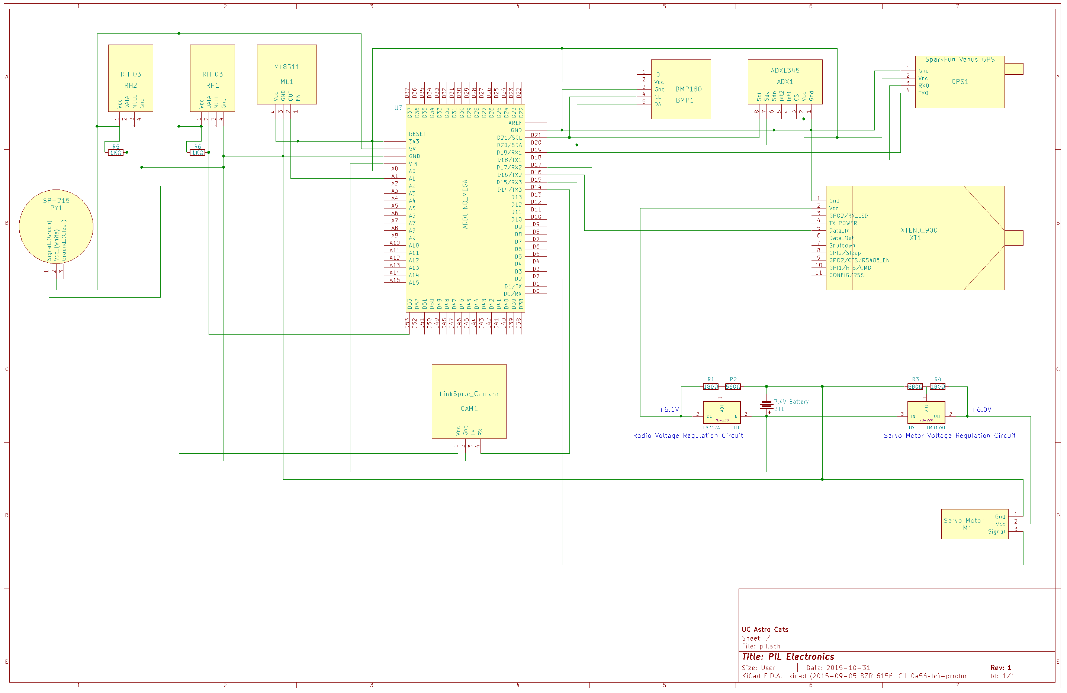
PIL Electronic Schematic
Notes:
Jake

Slide 42
Ground Control Hardware
Arduino Mega 2650
Microcontroller that interfaces the radio transceiver with the PC
Sends incoming radio data from the PIL and Tracking Bay to the PC
Sends outgoing commands to the radio, to transmit to the PIL
XTEND-900 - Radio transceiver
PC - A laptop used to interface with the Arduino
Collect and display gathered data using custom software
Notes:
Jake

Slide 43
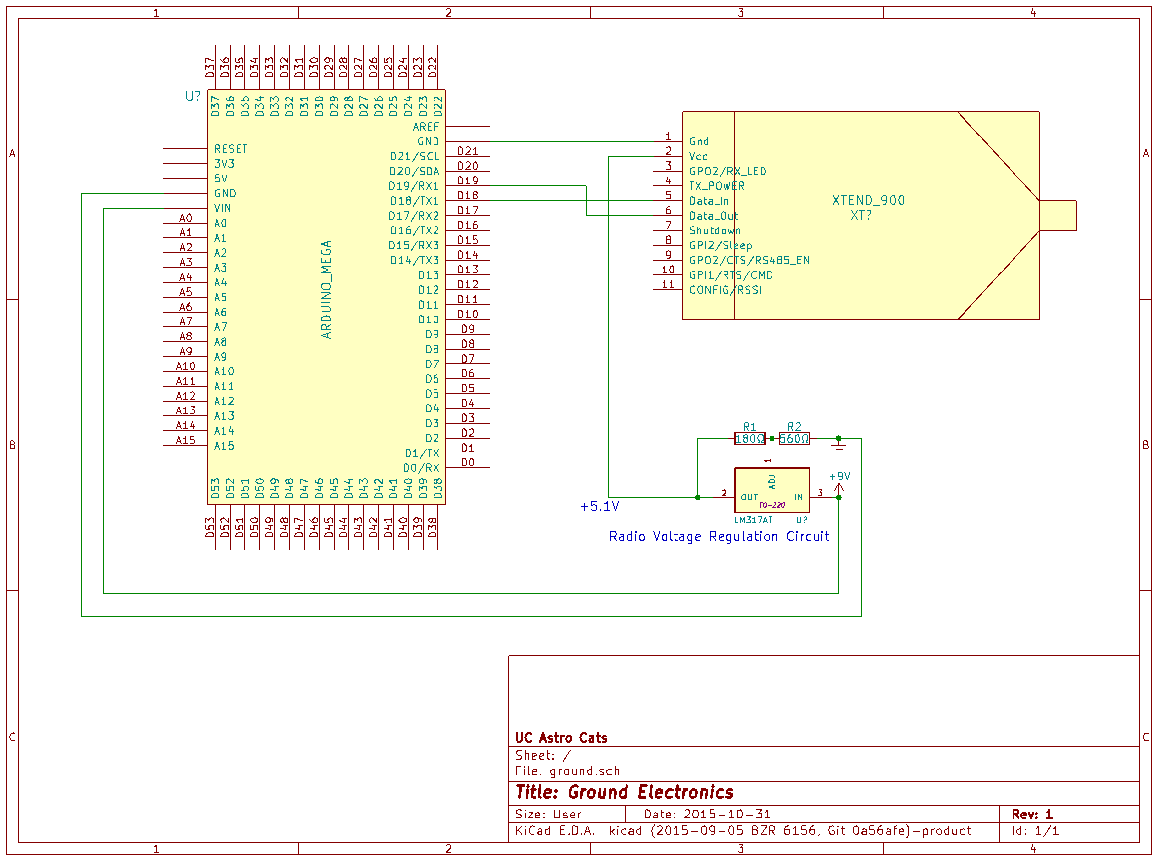
Ground Control Electronic Schematic
Notes:
Jake

Slide 44
Ground Control Software
Arduino will collect data from radio that has been received from PIL and Rocket Tracking Bay, and send it to the PC over serial connection.
PC will utilize custom software that retrieves serial data sent from the Arduino.
Data will be parsed and the user interface display will be updated in real time with new data.
wxWidgets C++ GUI Library being used for GUI.
Notes:
Jake

Slide 45
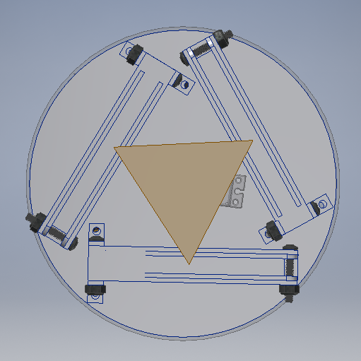
System Integration - PIL and landing module
Notes:
Brandon

Slide 46
System Integration - PIL & Ground Ops
Notes:
Brandon

Slide 47
System Integration - PIL & Rocket
PIL and Rocket integration
Payload adapter sleeve
PIL slides into Adapter Sleeve
Fairing Slides over Adapter Sleeve
Adapter Sleeve is fixed to rocket
Notes:
Brandon

Slide 48
PIL Mass Breakdown
Notes:
Brandon

Slide 49
Payload Testing Plan
 | Design Features to meet Requirement | Verification
 | The system is designed to be undamaged after launch with an easily replaceable motor. | This will be verified through testing.
 | The PIL system consists of all sensors necessary to record the atmospheric measurements at altitude and on the ground. | This will be verified through testing.
 | The PIL system is designed in a way to collect and transmit data at the required rate and for the required time. | This will be verified through inspection and testing.
 | The PIL system is design to hang in orientation under parachute at altitude and contains landing legs to remain in orientation on the ground. | This will be verified through testing.
 | The PIL system consists of onboard radios to transmit wirelessly to a ground station throughout the flight. Any missed packets of data will be retransmitted before end of operations on the ground. | This will be verified through testing.
 | The rocket contains a fairing and deployment mechanism. | This will be verified through analysis and testing.
 | The fairing system is tethered to PIL system, offering tracking and safe recovery of the fairing system. | This will be verified through inspection and testing.
Notes:
Brandon

Slide 50
Educational Engagement
Completed on November 4 at Winton Woods High School
200 high school students
Water Bottle Rocketry
Taught about thrust, stability, drag, and fin design
Feedback forms to be sent to high school this week
Documentation sent to NASA next week
Notes:
Andy

